Slide 1


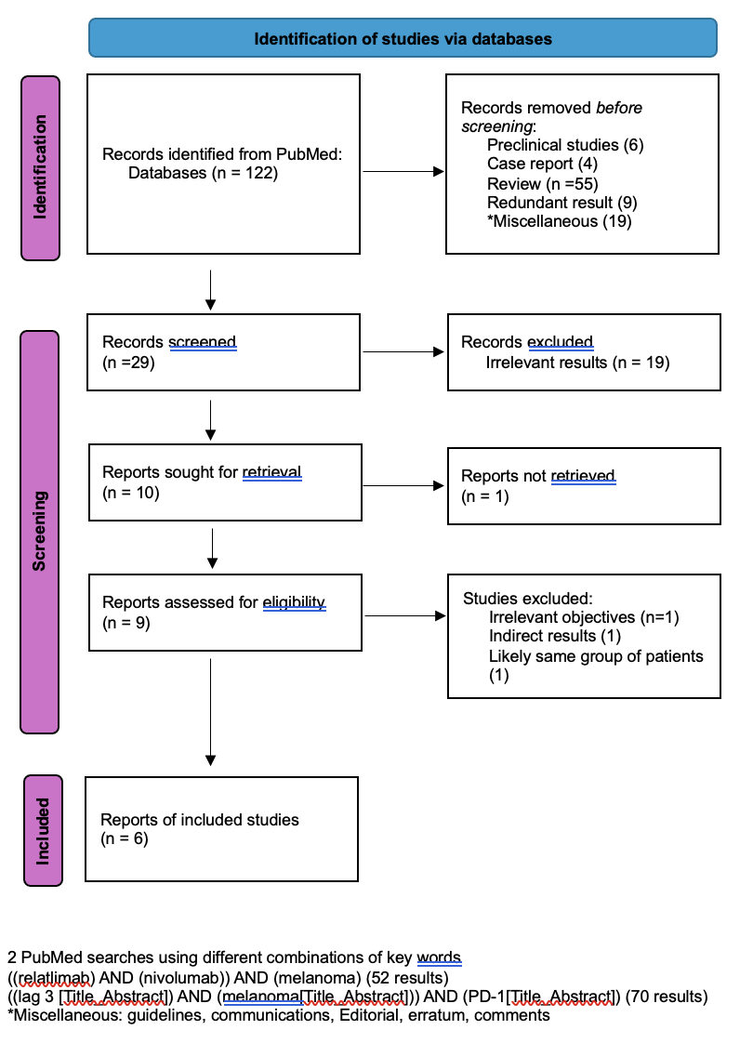
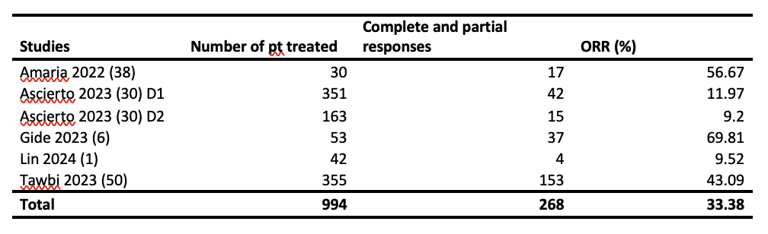
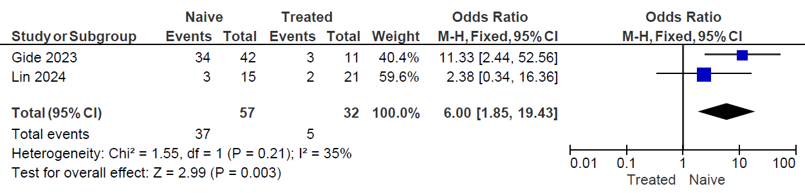
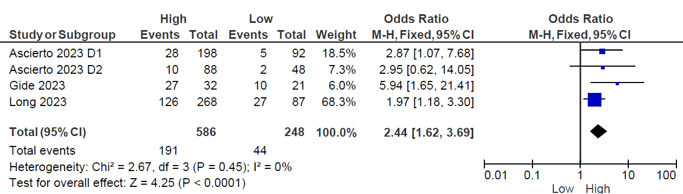

Combination of Anti-LAG-3 and Anti-PD-1 is Likely to Enhance Clinical Response in Patients with Melanoma, a Meta-analysis
Rachel E. Thomas, MA, OMS-1¹, Jun Wang, MD, PhD²
¹Osteopathic Medicine Student, DeBusk College of Osteopathic Medicine, Lincoln Memorial University, Knoxville, TN
²Department of Pathology, DeBusk College of Osteopathic Medicine, Lincoln Memorial University, Knoxville, TN
Abstract
Methods and Materials
Included Studies
Immunotherapy targeting programmed cell death-1 (PD-1) has improved clinical outcomes for melanoma treatment. Lymphocyte activation gene-3 (LAG-3) is expressed on the surface of T cells. Binding of LAG-3 to MHC II may cause suppression of T cell proliferation, resulting in immune evasion of melanoma. Several clinical trials have shown combination of anti-LAG-3 and anti-PD-1 resulted in better response and prolonged progression free survival. To further investigate this effect, meta-analysis was performed using published clinical outcomes of melanoma treatment with combined LAG-3 and PD-1 blockade. Studies of clinical efficacy of combined anti-LAG-3 and anti-PD-1 were collected through PubMed. 6 studies are included after screening for studies with similar methodologies that can be used for meta-analysis. Combination of anti-LAG-3 and anti-PD-1 resulted in different overall objective response rates (ORRs), ranging from 9.2% to 69.81%. ORRs are significantly higher in anti-PD1 naïve patients than those who were treated with anti-PD-1 previously, with an odd ratio of 6.00 [1.85, 19.43] (p=0.003). In addition, the clinical responses are significantly better in patients with high levels of LAG-3 expressing intratumoral lymphocytes, with an odd ratio of 2.44 [1.62, 3.69] (p<0.0001). These findings suggest that combination of anti-LAG-3 and anti-PD-1 immunotherapy improves clinical outcomes, especially in patients who never received anti-PD-1 treatments, or have high level LAG-3 expressing intratumoral lymphocytes.
Published studies on patients with melanoma treated with anti-LAG-3 and anti-PD-1 therapy were collected from PubMed. Various combinations of key words in title or abstract for LAG-3, relatlimab, nivolumab, and melanoma were used. Only original studies with combined treatment of anti-LAG-3 and anti-PD-1 and associated clinical outcomes were used. Reviews, preclinical studies, case reports, and studies that lacked specific outcomes were excluded. Full texts of the included studies were reviewed. Odd ratio was calculated using findings from relevant publications. Meta-analysis was conducted using RevMan5.
Results
1. Objective response rate of combined anti-LAG-3 and anti-PD-1 varies in different studies
Table 1. Overall objective response rate of combined anti-LAG-3 and anti-PD-1
2. Combined anti-LAG-3 and anti-PD-1 is more effective in anti-PD-1 naïve patients
Figure 2. Comparison of efficacy of combined anti-LAG and anti-PD-1 in patients with or without previous anti-PD-1
3. Efficacy of combined anti-LAG-3 and anti-PD-1 depends on levels of intratumoral LAG-3+ lymphocytes
Figure 3. Efficacy of combined anti-LAG and anti-PD-1 in patients with different levels of intratumoral LAG-3 positive lymphocytes
Figure 1. PRISMA 202 flow diagram for new systematic reviews which included searches of databases and registers only
Introduction
Discussion
Immune checkpoint factor programmed cell death-1(PD-1) is expressed mostly on CD8+ T cells^{1.} Activation of PD-1inhibits CD8+ T cells activity and results in immune evasion of malignant cell¹. Therefore, inhibition of PD-1 may suppress tumor growth by strengthening immune activity against tumor cells². Indeed, immune checkpoint inhibitors (ICI) PD-1 have been used to treat various malignant tumors, including melanoma, with promising clinical outcomes³.
Lymphocyte activation gene -3 (LAG-3) is expressed on immune cells and normally downregulates T cell proliferation². Upregulation of LAG-3 activity is seen in various cancers, likely associated with suppressed T cell function ⁴. This and increased release of immune suppressive cytokines appears to be associated with reduced anti-neoplastic immune activity, resulting immune evasion of neoplasms³.
LAG-3 inhibitors have been used in combination with anti-PD-1 for melanoma treatment⁵. To evaluate the clinical efficacy of this combination, meta-analysis was performed using published clinical observations of melanoma patients treated with combined anti-LAG-3 and anti-PD-1.
Addition of anti-LAG-3 to anti PD-1 results in better outcomes in melanoma treatment, although the objective response rate varies greatly.
Combined anti-LAG-3 and anti-PD-1 appears to be more effective in patients who never received anti-PD-1 treatment.
Combined anti-LAG-3 and anti-PD-1 appears to be more effective in melanoma with higher levels of LAG-3 positive intratumoral lymphocytes.
Assessment of intratumoral LAG-3 positive intratumoral lymphocytes before and during combined anti-LAG-3 and anti-PD-1 might be indicative of clinical responses.
References

